Slide 1

Historya

Slide 2
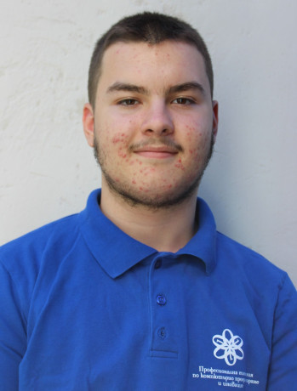
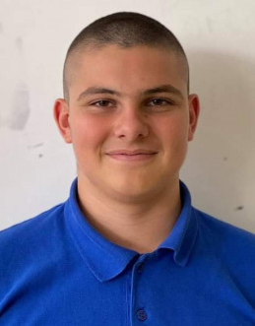
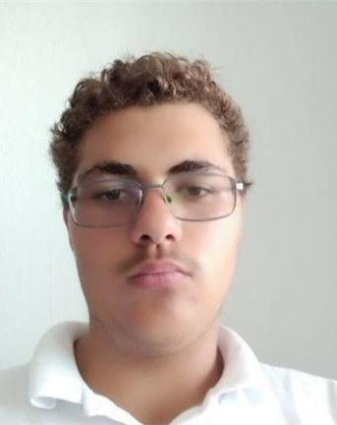
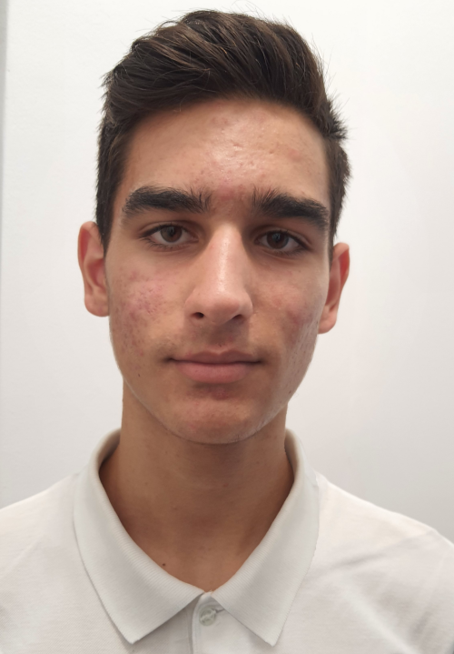
Team Members
Scrum Trainer: Miroslav Ivanov 10V
Front-End Dev:
Georgi Ivanov
10B
QA Engineer:
Petar Spasov
10G
Back-End Dev: Kostadin Taligadziev 10A

Slide 3






What we used to create the project:

Slide 4



Realization
Idea
Creation of the project
Finished product

Slide 5

The project

Slide 6
Thank you for your attention!

